Slide 1












MICROSOFT MOVIE BUSINESS
ALIENS AND
ANIME
CYCY
WANYEKI

Slide 2
FILM BUSINESS Movie business is extremely diverse owing to the many genres there are, not forgetting the joint-genres. It is, therefore, very necessary to venture into the business with as much insights as possible. Microsoft definitely has plenty of money to jump in on the big budget movies immediately and given they have an existing brand that is very valuable, I want to present a balanced approach that considers ROI, total profit, and also "quality".

Slide 3
BUSINESS UNDERSTANDING The goal for any business is to make profits. For this particular business, it would be to make profits and make successful movies. Movie making is profitable as more movies make money than those that make losses. From the data we shall go through we shall see this and also see that a movie could get even up to 500% profits. An informed choice of movie genres to be produced will greatly help for the studio to gain traction from the get-go. Lets get into it, shall we!

Slide 4
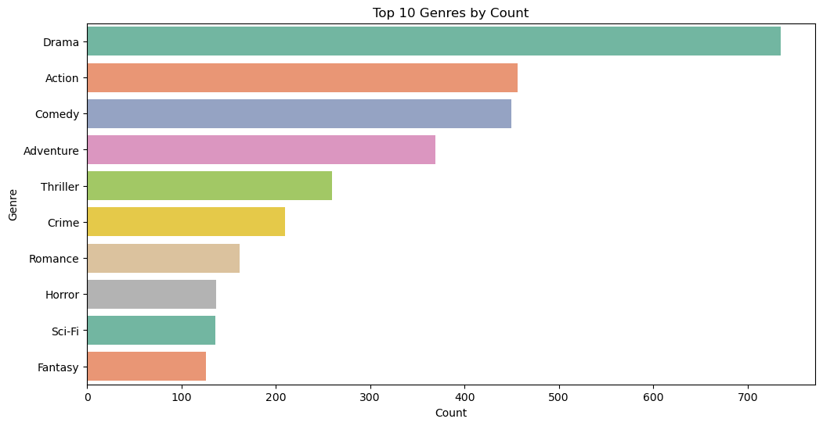

TTOP 10 GENRES BY COUNT
THE MOST PRODUCED GENRES ARE;
DRAMA
ACTION &
COMEDY

Slide 5
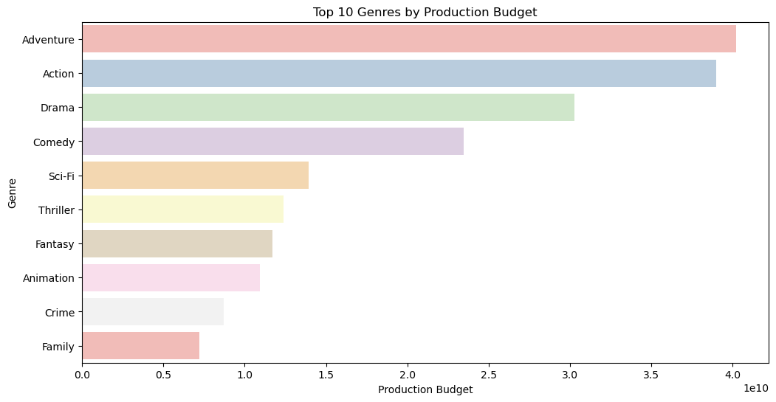
TTOP 10 GENRES BY PRODUCTION BUDGET
THE GENRES WITH THE HIGHEST PRODUCTION BUDGET ARE;
ADVENTURE
ACTION &
DRAMA

Slide 6
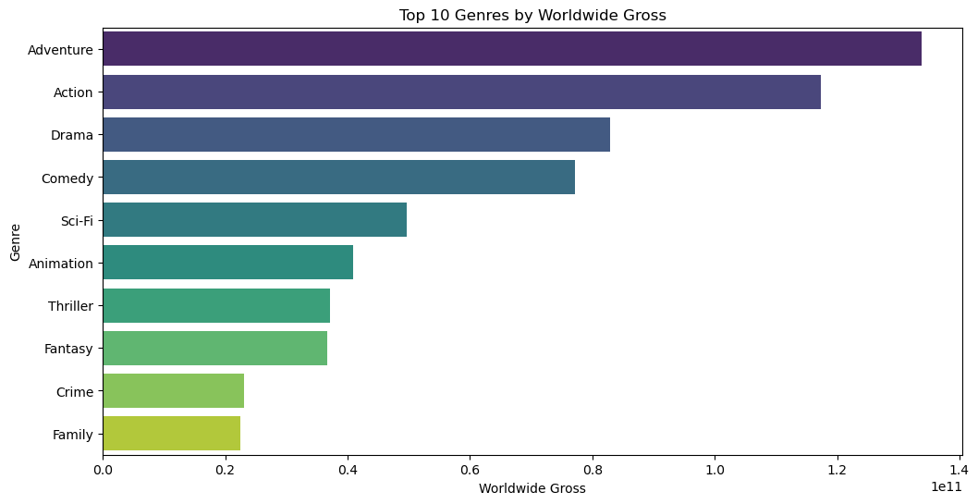
TTOP 10 GENRES BY PRODUCTION WORLDWIDE GROSS
THE GENRES WITH THE HIGHEST WORLWIDE GROSS ARE;
ADVENTURE
ACTION &
DRAMA

Slide 7
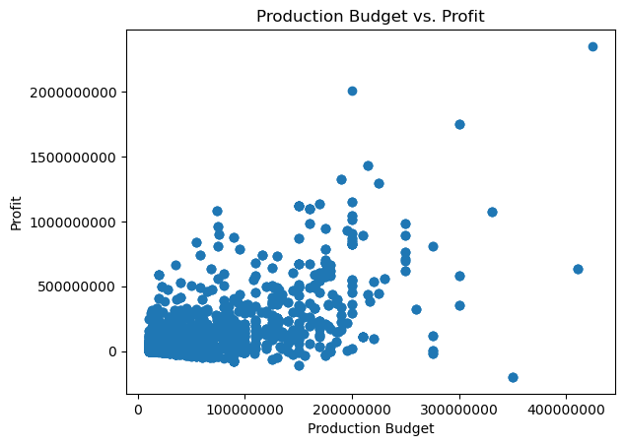
DATA CORRELATION
The correlation between average production budget and average profit is approximately 0.58. This is positive correlation suggests that, on average, genres with higher production budgets tend to produce higher profits in my dataset.

Slide 8






CONCLUSION
THE OVERALL CONCLUSION IS THAT THE MOVIE INDUSTRY IS A PROFITABLE VENTURE FOR MICROSOFT.
MICROSOFT SHOULD INVEST IN GENRES SUCH AS ADVENTURE , ACTION & DRAMA TO MAXIMIZE ON PROFIT RETURNS.

Slide 9
RECOMMENDATIONS
Microsoft should invest in genres such as adventure , action & drama to maximize on profit returns.
Leverage the positive correlation between production budget and profit by allocating higher budgets to 'adventure' and 'action' projects.
However, maintain a balanced portfolio by investing in lower-budget genres with strong storytelling potential.

Slide 10






THANK YOU!
CYNTHIA WANYEKI
+254111631012
LINKEDIN; CYNTHIA WANYEKI
ALIENS AND
ANIME

